Slide 1
Utilizing Kerberos authentication for kerberized services and Web Single Sign-On using Open-Source software
door Frederik Van Den Hof en Beerend Lauwers

Slide 2
Overzicht
Single Sign-On
Client
Server
Kerberos Authentication Protocol
Implementatie
DNS
NTP
MIT Kerberos
Kerberized Services
Remote Access (telnet, rlogin, SSH)
FTP
Web-SSO
Linken met Active Directory
Discussie en conclusie

Slide 3
Overzicht
Single Sign-On
Client
Server
Kerberos Authentication Protocol
Implementatie
DNS
NTP
MIT Kerberos
Kerberized Services
Remote Access (telnet, rlogin, SSH)
FTP
Web-SSO
Linken met Active Directory
Discussie en conclusie

Slide 4
Single Sign-on
Éviter le nuissance de faire connexion tous les temps
Améliorer l’efficience
Client < > Server

Slide 5
À base de client
- Sauvegarder les mots de passes sur le client
- Besoin d’une contribution de l’utilisateur
+ Pas besoin d’une infrastructure centralisée

Slide 6
À base de client
Ne pas assez flexible
Approprié pour un ordinateur personnel
Novell

Slide 7
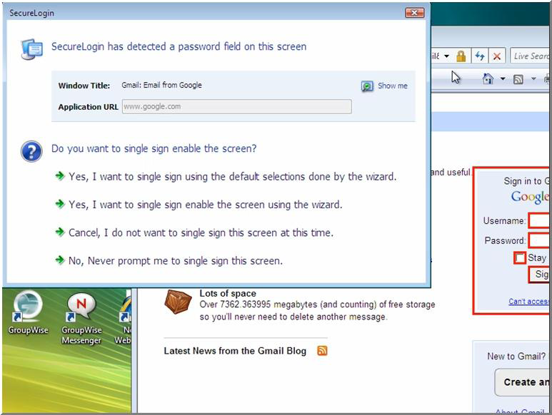
À base de client

Slide 8
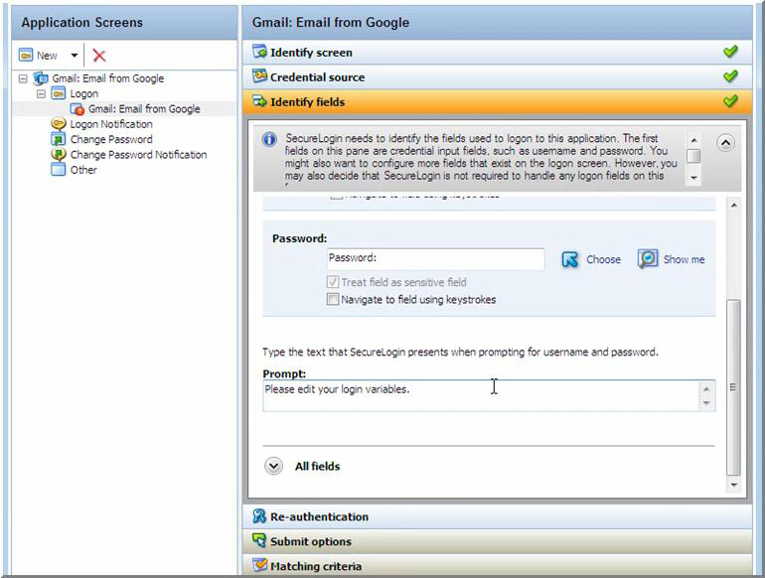
À base de client

Slide 9
À base de server
1 server d’authentication centralisé
Gère tous les demandes d’authentication
1 ticket
Comme un station de ski

Slide 10
Tout ou rien
Secure
Tout où rien
Accès à tout

Slide 11
À base de server
Améliorer l’efficience
Extensibilité
Mail
Intranet
Oracle
Etc.
Beaucoup de travail

Slide 12
Overzicht
Single Sign-On
Client
Server
Kerberos Authentication Protocol
Implementatie
DNS
NTP
MIT Kerberos
Kerberized Services
Remote Access (telnet, rlogin, SSH)
FTP
Web-SSO
Linken met Active Directory
Discussie en conclusie

Slide 13

Kerberos authentication protocol
AS-REQ
Username
Timestamp

Slide 14

Kerberos authentication protocol
AS-REP
Client/TGS session key
Ticket Granting Ticket
Client/TGS session key

Slide 15

Kerberos authentication protocol
TGS-REQ
Ticket Granting Ticket
Client/TGS session key
Authenticator
username
Timestamp

Slide 16

Kerberos authentication protocol
TGS-REP
Client-service session key
Service ticket
Username
Requested service
Client-service session key

Slide 17
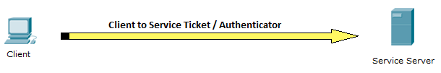
Kerberos authentication protocol
Service REQ
Authenticator
Username
Timestamp
Service Ticket
Client service session key

Slide 18
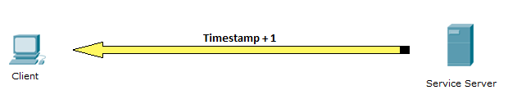
Kerberos authentication protocol
Service REP
Timestamp +1

Slide 19
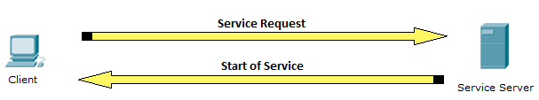
Kerberos authentication protocol
Begin of service

Slide 20
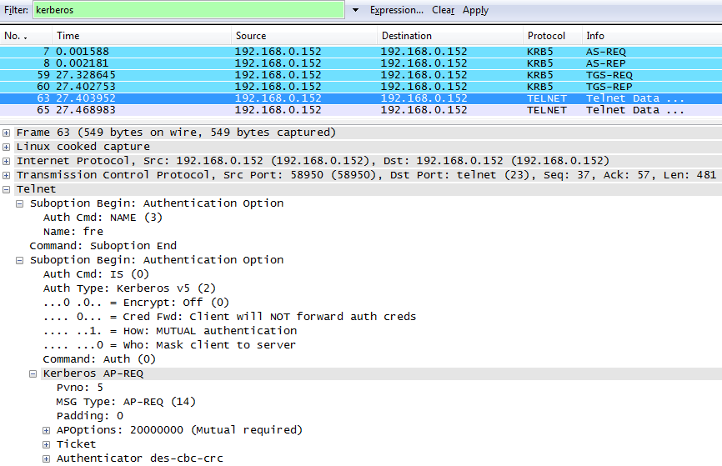
Kerberos authentication protocol

Slide 21
Kerberos benefits
A user’s password is never sent over the network.
All communication is encrypted and can only be cracked through brute-force methods.
Single sign-on capabilities are achieved within a certain time span, usually one day.
Passwords are stored in a single location: the Key Distribution Center.

Slide 22
Kerberos drawbacks
The Key Distribution Center is a single point of failure. If unavailable due to hardware problems or Denial-of-Service attack, secure authentication is made impossible. These risks can however be reduced by setting up a master/slave or a multi-master setup. If a hacker manages to gain root access on the KDC, he will have access to the encrypted passwords and the Kerberos configuration files. Therefore, it is imperative the KDC is well protected.
On a multi-access system, tickets stored locally in a user’s temporary folder can be possibly copied by another user, who can then use each ticket during its validity period.
A hacker may intercept a ticket and then represent that ticket to gain access to the system without knowing the user password. This is called a replay attack, and is mitigated by methods such as time skewing and authenticator caching. However, to be completely safe from replay attacks, all communication between the client and the service server should be encrypted with the Client/Service key, which the hacker cannot acquire at any given time [4].
Sniffers on the client computer may steal the unencrypted user password. A strong company password policy should be enforced to prevent this situation.
Weak passwords may be easily guessed or brute-forced. Again, a strong company policy should attempt to prevent weak passwords from being used.
The previous version Kerberos, V4, contains several buffer overflow exploits and suffers from weak default encryption methods. A KDC that accepts V4 tickets will also be vulnerable to these attacks. Therefore, it is important that outdated services are upgraded to use Kerberos V5 and the KDC configured to ignore V4 requests [5].
Kerberos is an “all-or-nothing” approach: encrypting all remote logins, but sending e-mail passwords over the network unencrypted defeats the purpose of Kerberos encryption.
Trojaned Kerberos (kinit, klist) commands could steal the unencrypted password and send it to a malicious user who can then assume the identity of a valid user

Slide 23
Overzicht
Single Sign-On
Client
Server
Kerberos Authentication Protocol
Implementatie
DNS
NTP
MIT Kerberos
Kerberized Services
Remote Access (telnet, rlogin, SSH)
FTP
Web-SSO
Linken met Active Directory
Discussie en conclusie

Slide 24
Implementatie
todo
DNS – NTP – MIT Kerberos – Kerberized Services – Active Directory

Slide 25
Kerberized Services
Remote Access
telnet
Login
SSH
FTP
Web-SSO
DNS – NTP – MIT Kerberos – Kerberized Services – Active Directory

Slide 26
Kerberized Services – Web-SSO
Web server
XAMPP 1.7.4 Beta 3
Kerberos plugins
mod_auth_kerb 5.4
php_krb5 1.0 RC2
DNS – NTP – MIT Kerberos – Kerberized Services – Active Directory

Slide 27
Kerberized Services – Web-SSO
GSSAPI
Generic Security Services Application Program Interface
Provides framework for security implementations
Secure authentication, authorization and communication
Used in many kerberized applications
DNS – NTP – MIT Kerberos – Kerberized Services – Active Directory

Slide 28
Kerberized Services – Web-SSO
Negotiate Mechanism: SPNEGO (Simple and Protected GSSAPI Negotiation Mechanism)
NTLM / Kerberos
Functionality
Browser does HTTP/GET
Server returns WWW-Authenticate: Negotiate
Browser does HTTP/GET with Authentication header
Server returns either 401/UNAUTHORIZED or 200/SUCCESS
Used by both mod_auth_kerb and php_krb5
DNS – NTP – MIT Kerberos – Kerberized Services – Active Directory

Slide 29
Kerberized Services – Web-SSO
mod_auth_kerb
Apache module
Benefits
True SSO
No session variables required
Drawbacks
HTTP overhead
Many TGS requests
No HTML-based login
Required client configuration
DNS – NTP – MIT Kerberos – Kerberized Services – Active Directory

Slide 30
Kerberized Services – Web-SSO
php_krb5
PHP extension
Benefits
HTML-based login
Reduced TGS communication compared to mod_auth_kerb
Support for GSSAPI bindings inside PHP
Drawbacks
Our implementation relies on session variables
Increased complexity
Interfered with web mail interface
Cannot be used across server farms
DNS – NTP – MIT Kerberos – Kerberized Services – Active Directory

Slide 31
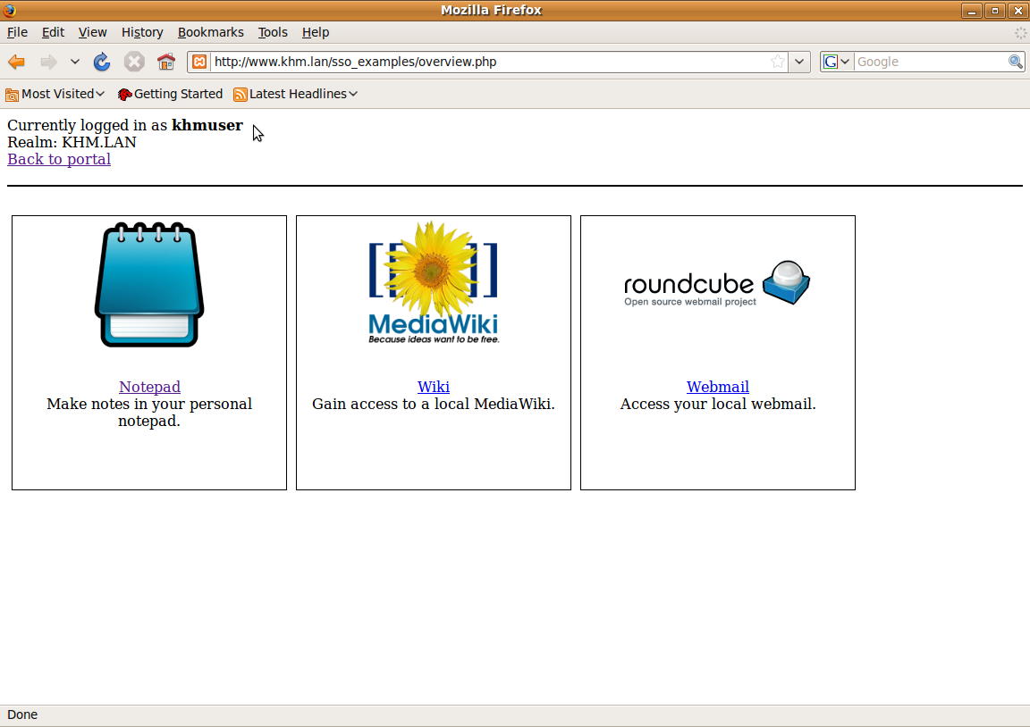
Kerberized Services – Web-SSO
Proof-of-concept SSO portal
In-house notepad application
Kerberized MediaWiki
Kerberized web mail interface
DNS – NTP – MIT Kerberos – Kerberized Services – Active Directory

Slide 32
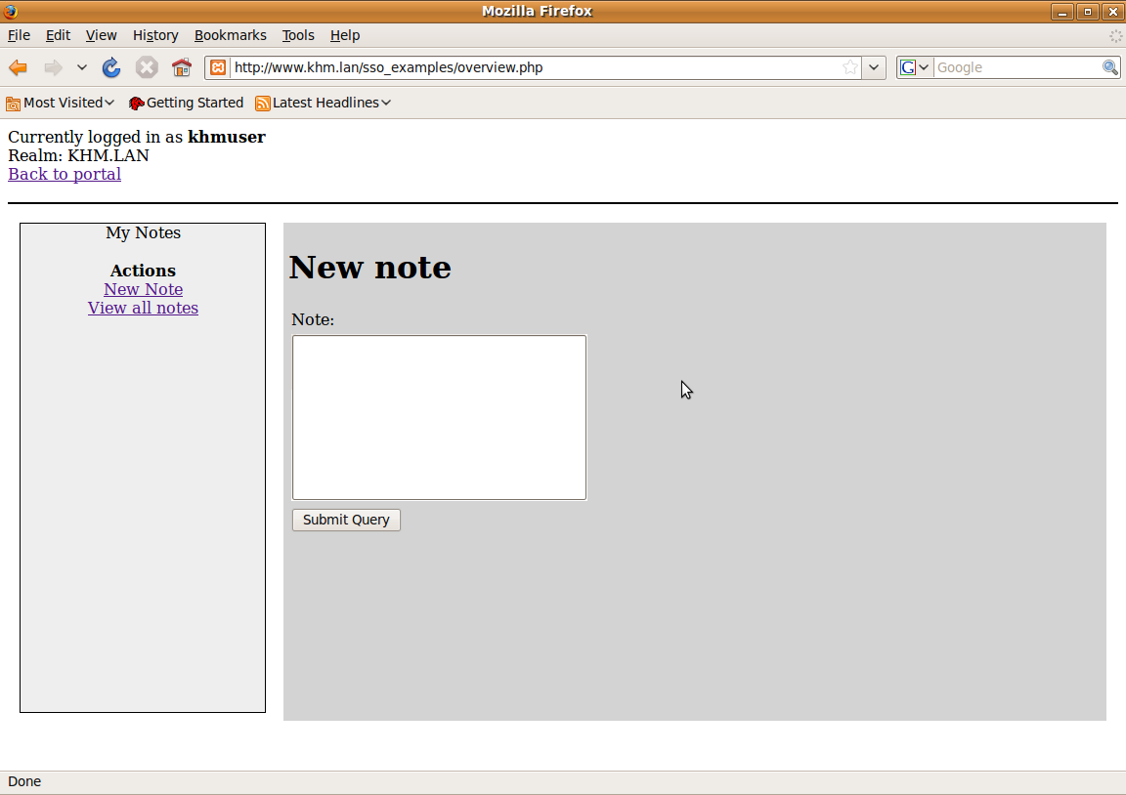
Kerberized Services – Web-SSO
In-house notepad application
DNS – NTP – MIT Kerberos – Kerberized Services – Active Directory

Slide 33
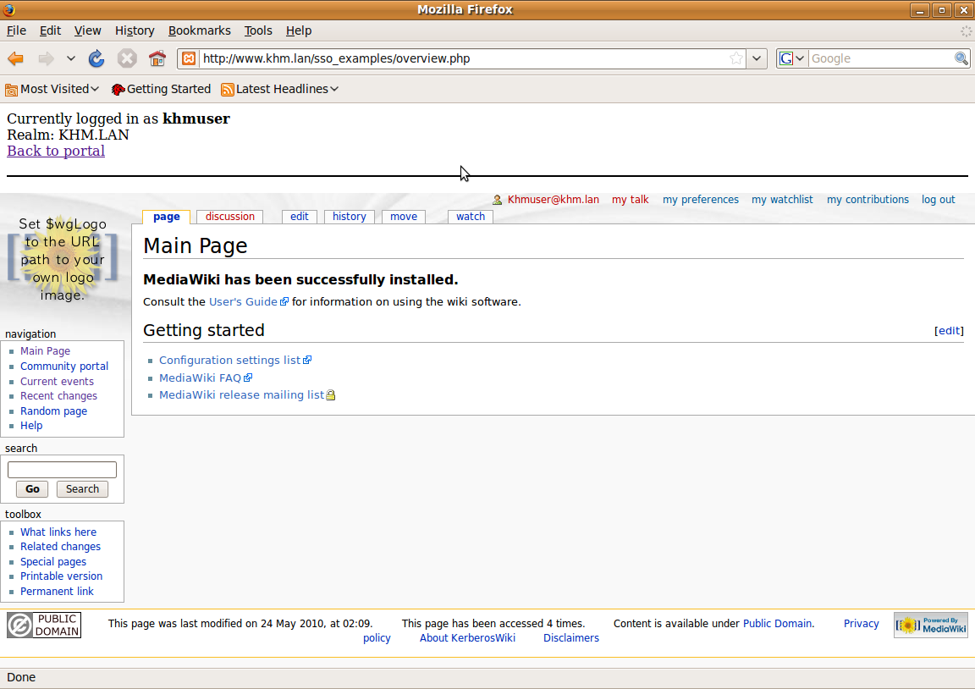
Kerberized Services – Web-SSO
Kerberized MediaWiki
DNS – NTP – MIT Kerberos – Kerberized Services – Active Directory

Slide 34
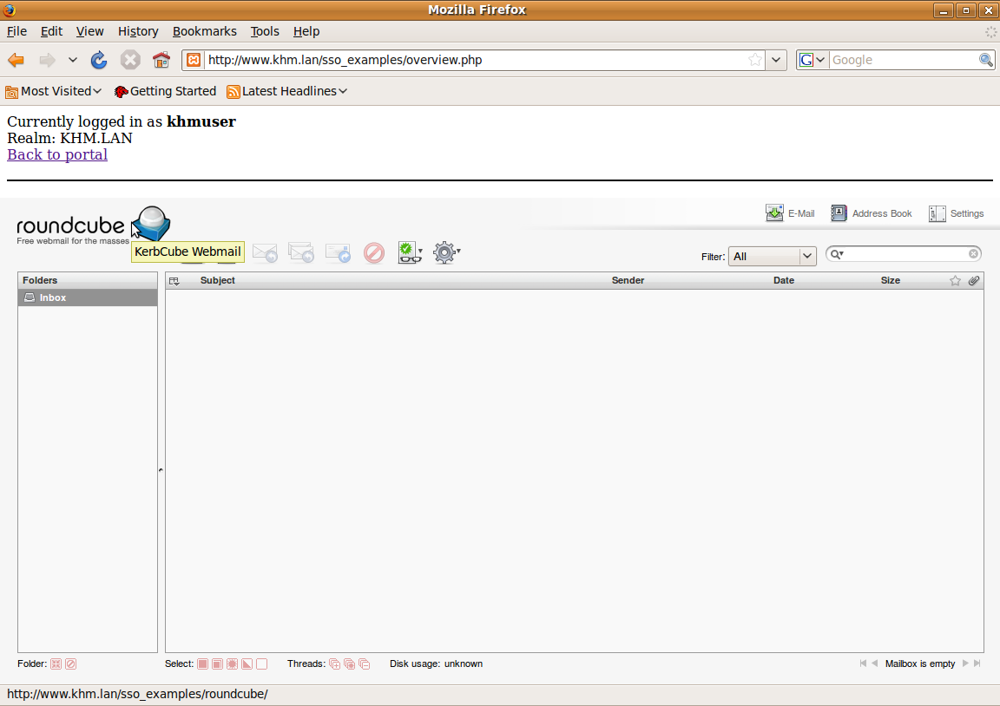
Kerberized Services – Web-SSO
Kerberized web mail interface
DNS – NTP – MIT Kerberos – Kerberized Services – Active Directory

Slide 35
Kerberized Services – Active Directory
Windows 2003 Active Directory Domain: windows.lan
Explored options:
Authenticate with kinit as Windows user on a Linux machine
Use Windows user credentials on php_krb5 portal
Installation & Configuration
Create Two-way trust between AD domain and Kerberos Realm
Testing the setup
DNS – NTP – MIT Kerberos – Kerberized Services – Active Directory

Slide 36
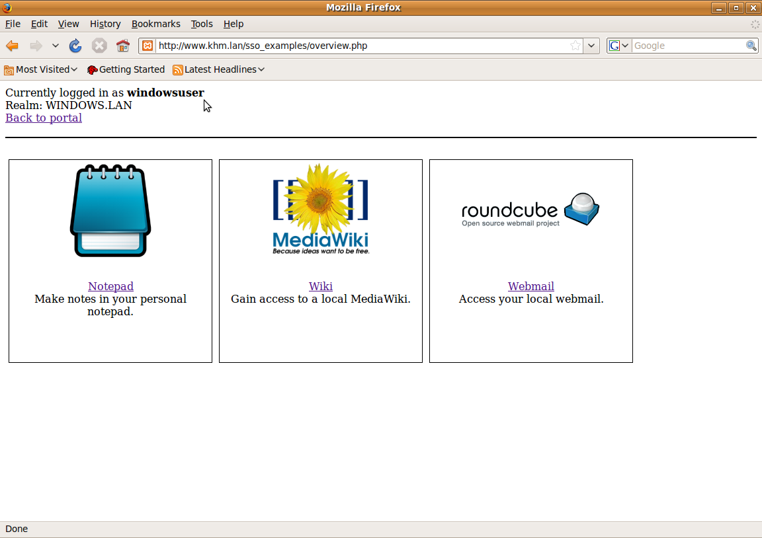
Kerberized Services – Active Directory
Testing the setup
DNS – NTP – MIT Kerberos – Kerberized Services – Active Directory

Slide 37
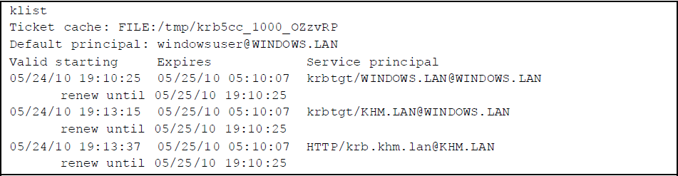
Kerberized Services – Active Directory
Testing the setup
DNS – NTP – MIT Kerberos – Kerberized Services – Active Directory

Slide 38
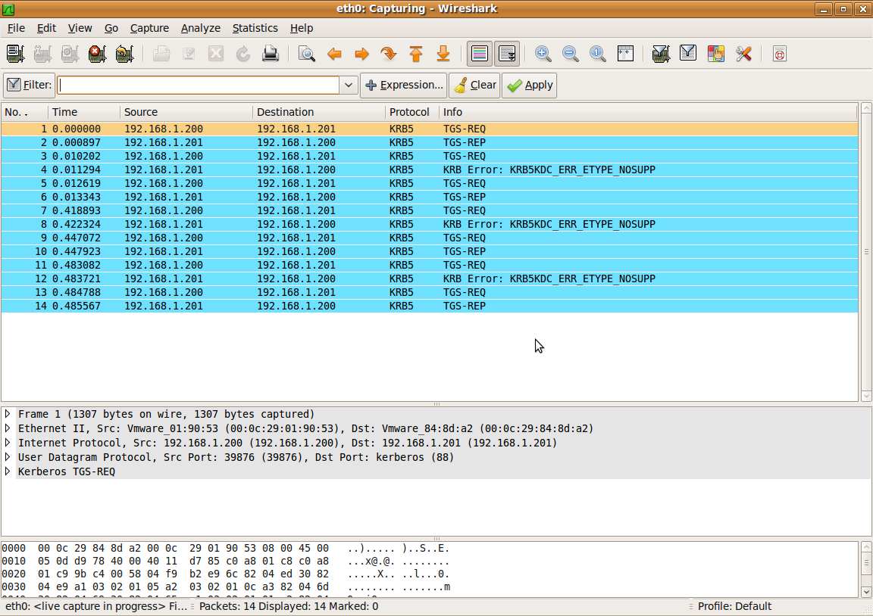
Kerberized Services – Active Directory
Testing the setup
TGT request
Resource request
DNS – NTP – MIT Kerberos – Kerberized Services – Active Directory

Slide 39
Overzicht
Single Sign-On
Client
Server
Kerberos Authentication Protocol
Implementatie
DNS
NTP
MIT Kerberos
Kerberized Services
Remote Access (telnet, rlogin, SSH)
FTP
Web-SSO
Linken met Active Directory
Discussie en conclusie

Slide 40
Discussie en conclusie
Discussie
Web-SSO met mod_auth_kerb en php_krb5
Verdere integratie met Windows services
Conclusie

Slide 41
Discussie en conclusie
Web-SSO met mod_auth_kerb en php_krb5
GSSAPI-bindings van php_krb5
Wijde ondersteuning en gebruik
Java: JAAS (Java Authentication and Authorization Service)
Cyrus & Postfix ondersteunen GSSAPI
SPNEGO en SASL (Simple Authentication and Security Layer)
Perl en C modules
Mogelijke scenario’s
Web mail
Web-based telnet of SSH
Web-based remote desktop
Aanpassing bestaande frameworks (bv. Horde)
Nieuwe frameworks communiceren veilig met andere applicaties

Slide 42
Discussie en conclusie
Web-SSO met mod_auth_kerb en php_krb5
SSO frameworks

